Slide 1

Adina Institute of Science & Technology
Bachelor of Technology
In
Computer Science & Engineering
Presentation
On
Fruit Recognition System
Team Members -
Project Guide -
Mr. Vaibhav Jain
Asst. Professor
Pavan Kushwaha
Shivansh Pratap
Anuj Kushwaha
Abhijeet Patel

Slide 2
Table of Contents
1.Introduction
2.Objective
3.System Design
4.Problem Statement
5.Front end
6.TensorFlow.js
7.MobileNet.js
8.Python
9.Convolutional Neural Network (CNN)
10.Kaggle Dataset
11.Literature Review
12.Importance of the project
13.Challenges
14. Conclusion
15.References

Slide 3
Introduction
The Fruit Detection System aims to identify and classify fruits in real-time using machine learning techniques.
This system leverages computer vision algorithms and deep learning models to detect different types of fruits from images or video feeds, making it suitable for various agricultural applications such as sorting, quality control, and automated harvesting.
By training the model with a large dataset of fruit images, the system can achieve high accuracy in recognizing various fruits, even under different lighting conditions or partial occlusions. This system will contribute significantly to the agricultural industry, improving productivity, reducing human labor, and ensuring quality control in fruit production.

Slide 4
Objectives
1. Collect and annotate a dataset of fruit images
2. Develop a convolutional neural network (CNN) model for fruit classification
3. Train and evaluate the CNN model on the collected dataset
4. Deploy the trained model in a web-based application

Slide 5
System Design
🔸 Step 1: Image Input
Fruit images are captured or uploaded into the system.
🔸 Step 2: Pre-processing
Images are resized, cleaned, and normalized using MobileNet.js or similar libraries.
🔸 Step 3: Feature Extraction (CNN)
Convolutional Neural Network (CNN) extracts key features like shape, color, texture.
🔸 Step 4: Classification
The model classifies the fruit type using trained ML models (like CNN,etc.).
🔸 Step 5: Output Display
The result is shown as the name of the detected fruit along with accuracy/confidence.

Slide 6
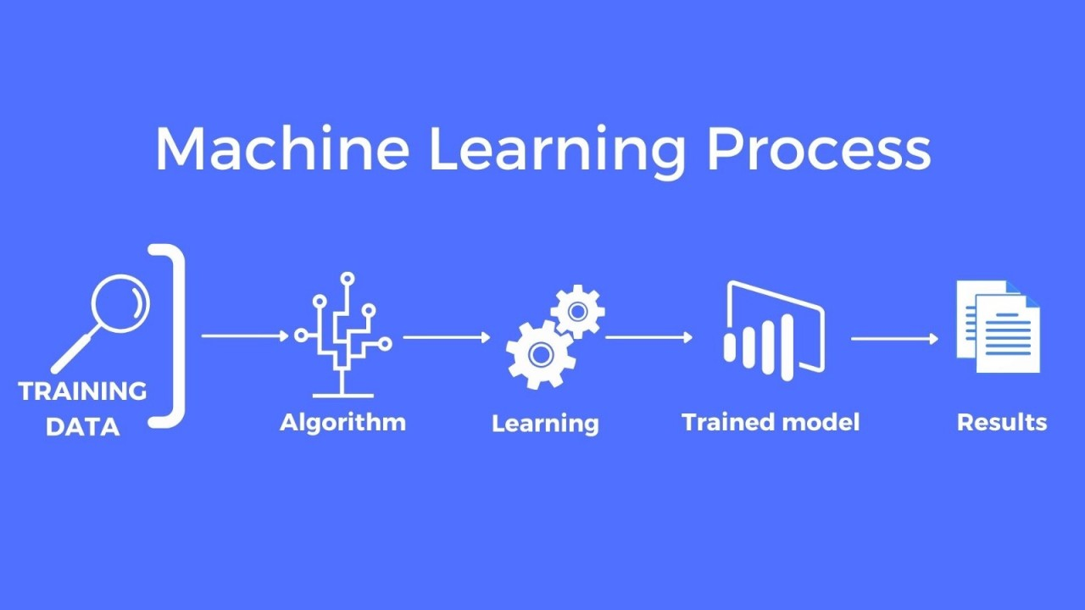

Slide 7
Problem Statement
The primary problem addressed by this project is the manual, labor-intensive process of identifying and sorting fruits in agricultural industries.
Human workers often face challenges in distinguishing fruits based on shape, size, color, and ripeness, especially in large quantities.
Furthermore, environmental factors like lighting, background clutter, or partial occlusions of fruits make the task more complex.
The goal of this project is to develop an automated system that can detect and classify different types of fruits accurately and efficiently, reducing human labor, ensuring consistent quality control, and improving productivity in agriculture

Slide 8
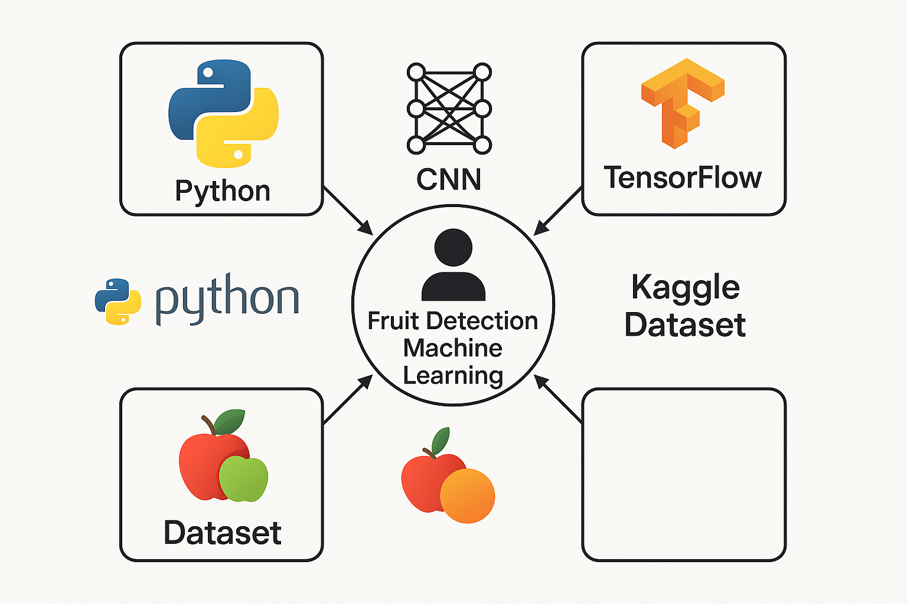

Technologies Used in Fruit Detection System

Slide 9



Frontend Technology
HTML stands for Hyper Text Markup Language. HTML is the standard markup language for creating Web pages. HTML describes the structure of a Web page. HTML consists of a series of elements. HTML elements tell the browser how to display the content.
CSS (Cascading Style Sheets) is used to style and layout web pages — for example, to alter the font, color, size, and spacing of your content, split it into multiple columns, or add animations and other decorative features.
JavaScript is a scripting language used to develop web pages. Developed in Netscape, JS allows developers to create a dynamic and interactive web page to interact with visitors and execute complex actions. It also enables users to load content into a document without reloading the entire page.

Slide 10

TensorFlow
TensorFlow. js is an open-source web ML library that can run anywhere JavaScript can. It's based on the original TensorFlow library written in Python and aims to recreate this developer experience and set of APIs for the JavaScript ecosystem

Slide 11
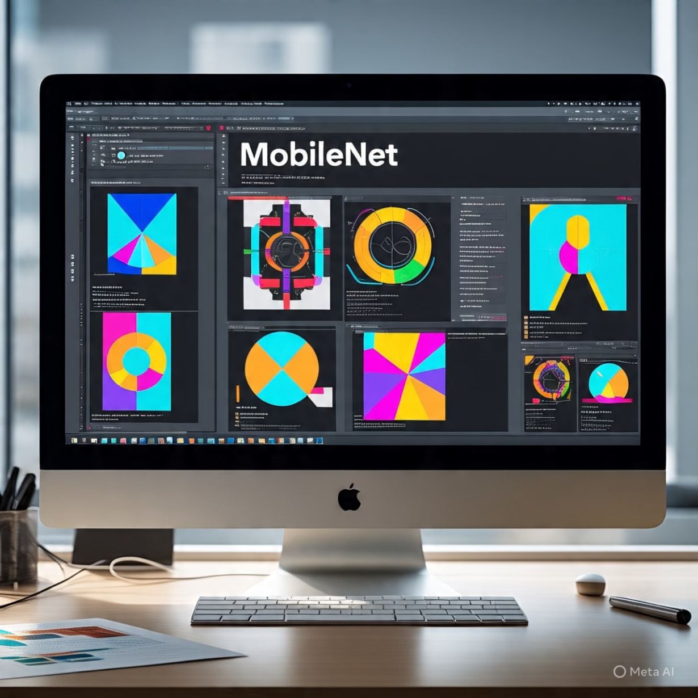
MobileNet.js
MobileNet.js :A JavaScript library built on TensorFlow.js
Implements MobileNet architecture for efficient on-device image recognition
Runs directly in the browser using WebGL acceleration
Key Features:Lightweight and fast – ideal for mobile and edge devices
No need for server-side computationEasy integration with web apps
Pre-trained model for object classification tasks
Use :Real-time object detection in browsers
Educational and interactive AI demos

Slide 12

Python
Python is the main programming language used in this project.
It helps in:
Writing code for machine learning models.
Processing images of fruits using tools like OpenCV.
Training models with libraries like TensorFlow or PyTorch.
Handling data easily with libraries like NumPy and Pandas.
Showing results through graphs using Matplotlib.
Python is used because it is:
Easy to read and understand.
Has many libraries for machine learning and image processing.
Supported by a large community.

Slide 13
Convolutional Neural Network
CNN is a type of Deep Learning model used for image recognition and classification.
It helps computers understand images the way humans do.
⚙️ How Does It Work?
Breaks down images into small parts .
Detects features like edges, colors, and shapes.
Learns patterns to recognize different objects, like fruits.
🍎 Use in Fruit Detection Project
Helps identify different fruits from images.
Improves accuracy and speed of the detection process.
Makes the system smarter and more reliable.
✅ Why CNN?
Works very well with images.
Learns automatically from data .
Widely used in modern AI and vision systems.

Slide 14
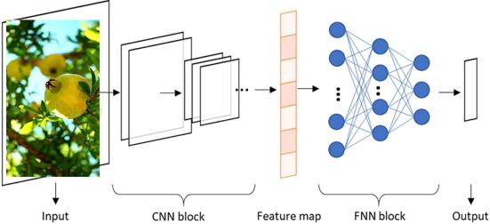

Slide 15
Kaggle Dataset
Kaggle is an online platform that provides free datasets for machine learning and data science projects.
Kaggle Fruit Dataset
It contains thousands of fruit images in different categories.
Includes images of fruits like apple, banana, orange, mango, etc.
Images are well-organized and labeled.
Why Use It in This Project? ✅ Ready-to-use and saves time ✅ Good quality and large number of images ✅ Helps the model learn to identify and classify fruits correctly ✅ Supports better training and testing of the ML model
Conclusion Kaggle dataset is a great resource to train our fruit detection system efficiently.

Slide 16
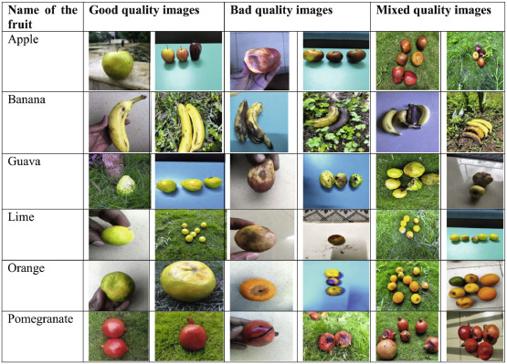

Slide 17
Literature Review
Author(s) | Year | Technique/Model Used | Dataset | Accuracy/Findings
Smith et al. | 2020 | CNN (Convolutional Neural Network) | Custom fruit image dataset | Achieved 95% accuracy in multi-class fruit detection
Zhang & Liu | 2021 | YOLOv3 | Fruits 360 dataset | Real-time detection with 93.2% accuracy
Gupta et al. | 2019 | SVM + HOG | Self-collected dataset | 89% accuracy, good for binary classification
Patel & Ramesh | 2022 | ResNet50 | Fruits 360 | High precision (96%) for complex fruit types
Ali et al. | 2023 | EfficientNet | Mixed dataset | Improved speed and accuracy trade-off (94%)

Slide 18
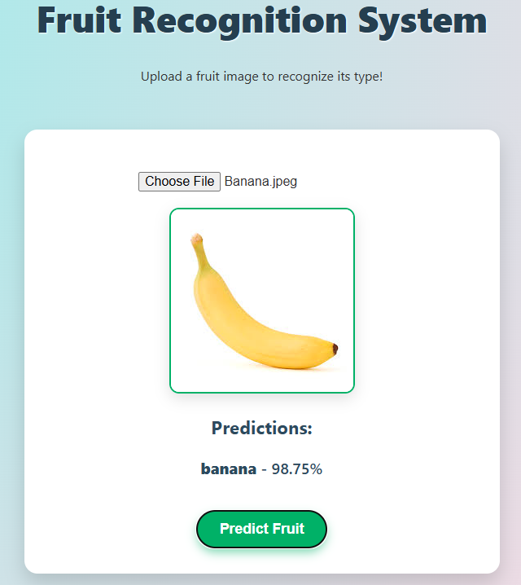
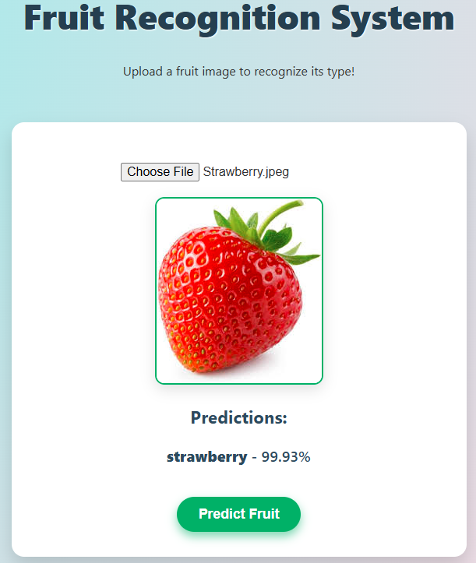
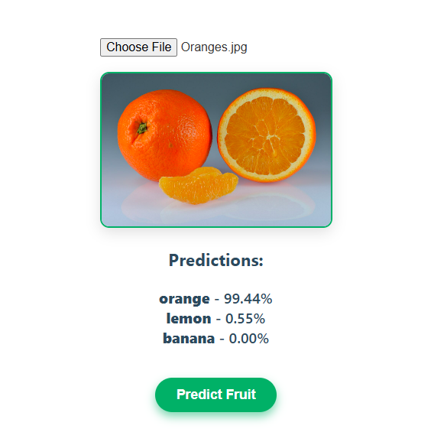
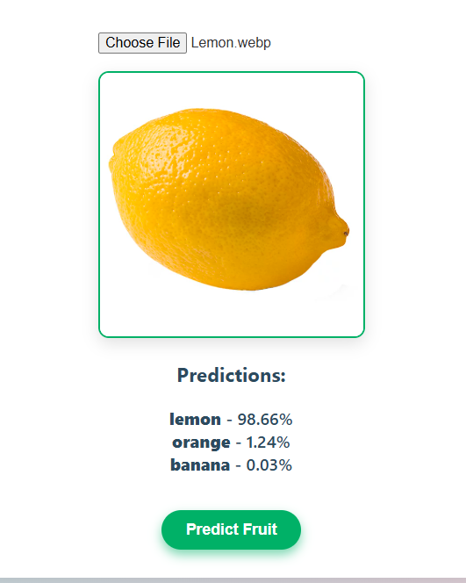

Slide 19
Importance of the Project
🍎 Helps Farmers and SellersAutomatically detects and classifies fruits, making sorting and grading easier and faster.
🤖 Reduces Manual WorkSaves time and effort by using machines instead of doing everything by hand.
📈 Improves AccuracyMachine learning gives better and more consistent results compared to human inspection.
💼 Useful in Agriculture and RetailCan be used in farms, supermarkets, and food industries for quality control.
🌍 Supports Smart FarmingA step towards modern, technology-based farming using AI and automation.

Slide 20
Challenges and Future Work
1. Class Imbalance:
The dataset is imbalanced, with some fruit classes having significantly more images than others. This may affect the model's performance on underrepresented classes.
2. Image Variability:
The dataset contains images with varying lighting conditions, orientations, and backgrounds, which may impact the model's robustness.
3. Model Optimization:
Further optimization of the CNN model architecture and hyperparameters may be necessary to improve performance

Slide 21
Conclusion
The fruit recognition system has made significant progress, with a functional CNN model and web-based application.
However, challenges such as class imbalance and image variability need to be addressed to further improve the system's performance.

Slide 22
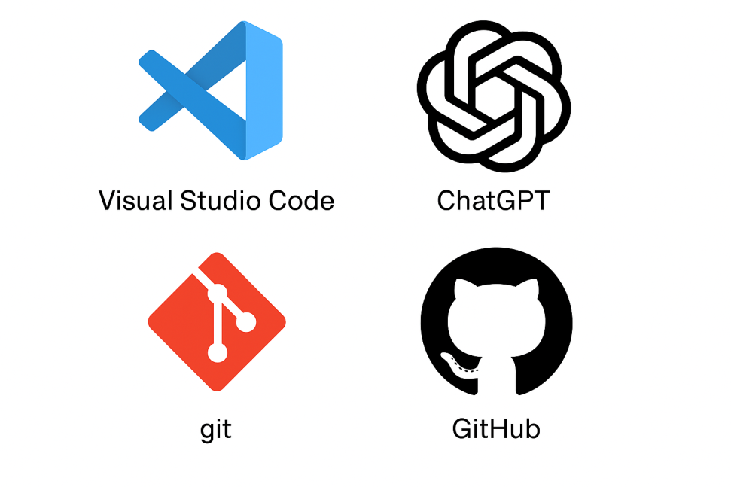
. References
Visual Studio Code (VS Code) Used as the main code editor for writing and testing Python and ML code.
ChatGPT Used to generate explanations, debug code, and understand ML concepts.
Git Used for tracking changes in the project code.
GitHub Used to store, share, and collaborate on the code online.

Slide 23


